Slide 1
Advanced Attitude Sensors for Satellite Celestial Navigation
Presenter: Shuhan Zheng
01
Notes:
(Greetings)
I’m presenting the idea of a startup building advanced sensors for celestial navigation, especially on artificial satellites

Slide 2
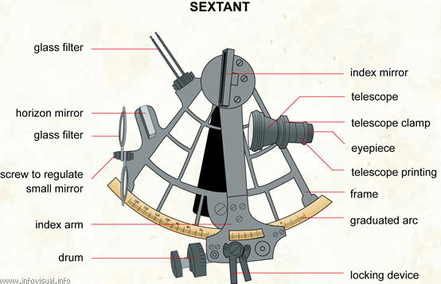
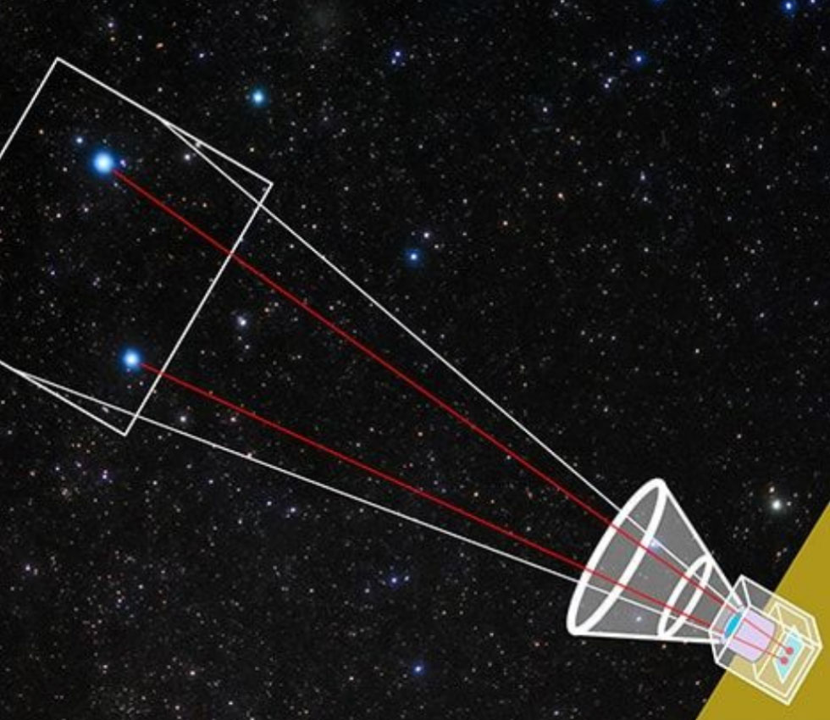
Celestial Navigation
Star Tracker
User: 18th century sailors
Positioning accuracy: approx. 1 nautical mile
Sensor: human eye
Used by satellites
Attitude accuracy: a few arcseconds
Sensor: modern camera
02
Notes:
Here’s a picture of a star tracker on a satellite, and a sextant used by 18th century sailors. What’s do they have in common?
We use them to find direction using stars.
Star trackers are very commonly used by spacecrafts for absolute attitude determination down to an arcsecond level accuracy.
They are basically glorified cameras in space.

Slide 3
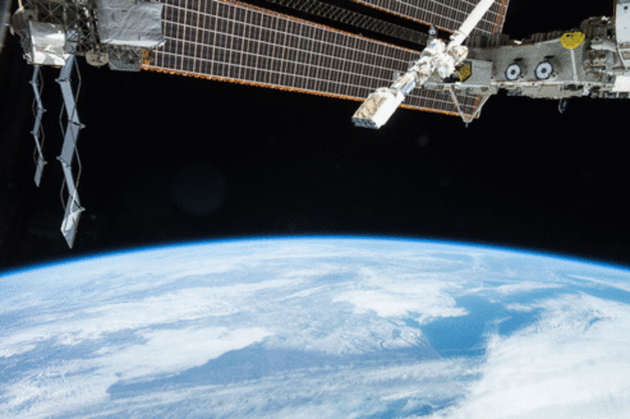
Conventional star trackers have a limit
Deployers induce tumble
Deployer | Max. rate (deg/s)
Nanoracks (ISS) | 10
Exopod (SpaceX Rideshare) | 17.5
Star trackers struggle to keep up
Model | Manufacturer | Max. rate (deg/s)
ST-HP | Rocket Lab | 3
Standard NST | Blue Canyon | 2
SASC | StarSpec | 1
03
Notes:
However, most commercial star trackers stop working when the satellite is rotating faster than 3 deg/s. Meanwhile, when a satellite has just been deployed and switched on, it can tumble at up to 10 deg/s or above. So, there exists a timeframe within a potentially million-dollar mission, where this device is just not operable. Basically, the images would be too blurry for the star tracker to resolve star locations.

Slide 4
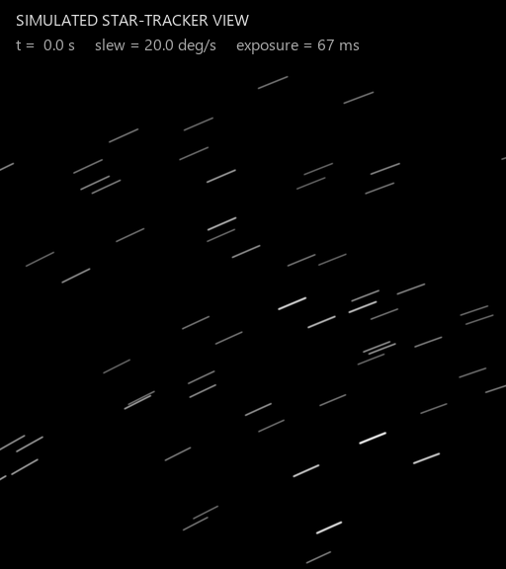
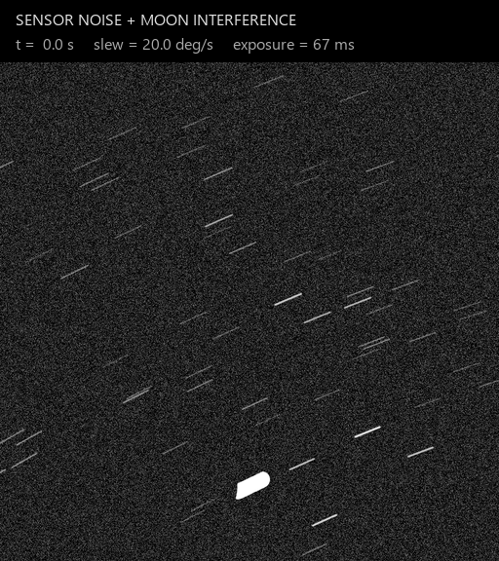
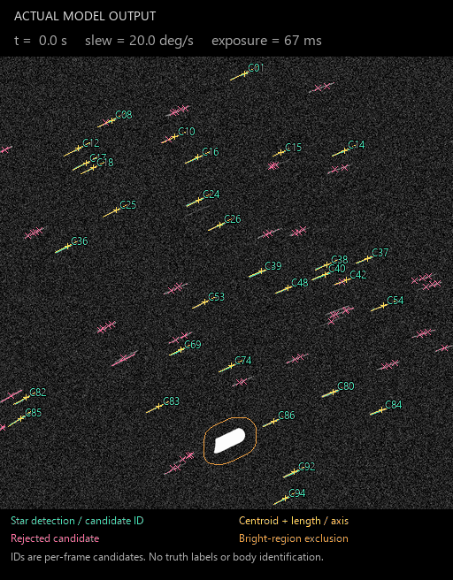
BEFORE / AFTER
High Dynamic Star Tracker (HDST)
04
Notes:
I developed the High Dynamic Star Tracker to solve this problem. A machine learning algorithm has been demonstrated to resolve the full 6-dimension attitude state from the blurry images. All it needs is slightly more compute than its competition and requires only off the shelf components. The maximum operable angular rate has been increased from the conventional 3 deg/s to 20. This has been tested against common sensor noises and celestial body interferences.

Slide 5
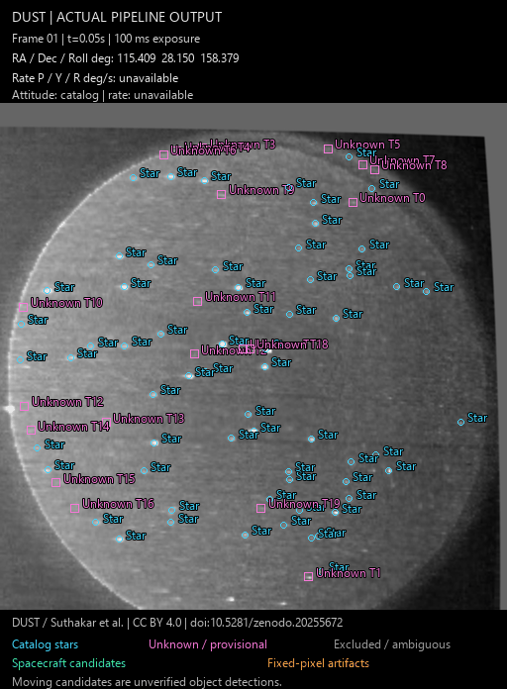
HDST as a Space Domain Awareness (SDA) sensor
Camera captures illuminated space objects
1
Detect candidates of moving objects
2
Line-of-sight observations
3
Report observations for orbit analysis
4
05
Notes:
Another benefit of this approach is to enable Space Domain Awareness capabilities. Other satellites, if they are illuminated by the sun, appear as bright spots moving across the starfield. The same algorithm HDST uses to determine the motion of stars moving across the field of view can be used to track satellites as well. This gif is from running the pipeline using an open-source stratospheric balloon star tracker dataset. As you can see, a green box highlights a spacecraft moving from the top of the frame to the bottom.
Another benefit of this approach is to enable Space Domain Awareness capabilities. The camera can capture illuminated space objects, which are typically satellites reflecting sunlight. Then it can detect those objects, and turn the LOS observations into information of those objects’ orbit. This is a capability currently only demonstrated on SpaceX’s Stargaze, which operates only on the Starlink network. With SDA being a really hot topic in the global aerospace industry, the HDST can bring sovereign SDA capabilities to Canada and its allies.

Slide 6
From software to space
SOFTWARE
HARDWARE
ENVIRO TESTING
ORBIT
Implement features
Test in simulation
Run with real data
Embedded development
Optics
Electrical
Structure
…
Physical simulator
Thermal vacuum
Stratospheric flight
…
Accumulate flight heritage
Feature complete
In Progress
06
Notes:
Right now, the software has finished tests using real and synthetic data. I’ve also began adapting it for power- and computation-scarce environments. After that, I would like to build a full working prototype, before sending it to environmental testing, which will give us substantial data so it can start earning flight heritage.

Slide 7

Let's build
what comes next.
Seeking cofounders:
FPGA & Embedded Systems • Spacecraft Engineering • Business Development
Shuhan Zheng
UTIAS M.Eng in Aerospace
Email: shuhan.zheng@mail.utoronto.ca
Cell: (+1) 438-495-6697
07
Notes:
I have built the initial technology myself, but there remains a lot of work between a software demonstration and something flight-ready. I’m looking for founders who want to take ownership in that challenge, especially in Embedded systems, spacecraft engineering, and business development. If this is something you’d like to build together, please come talk to me after the presentation. Thank you.

Slide 8
Q&A
08

